Slide 1
Arrays, Loops,
&
Command Line Args

Slide 2
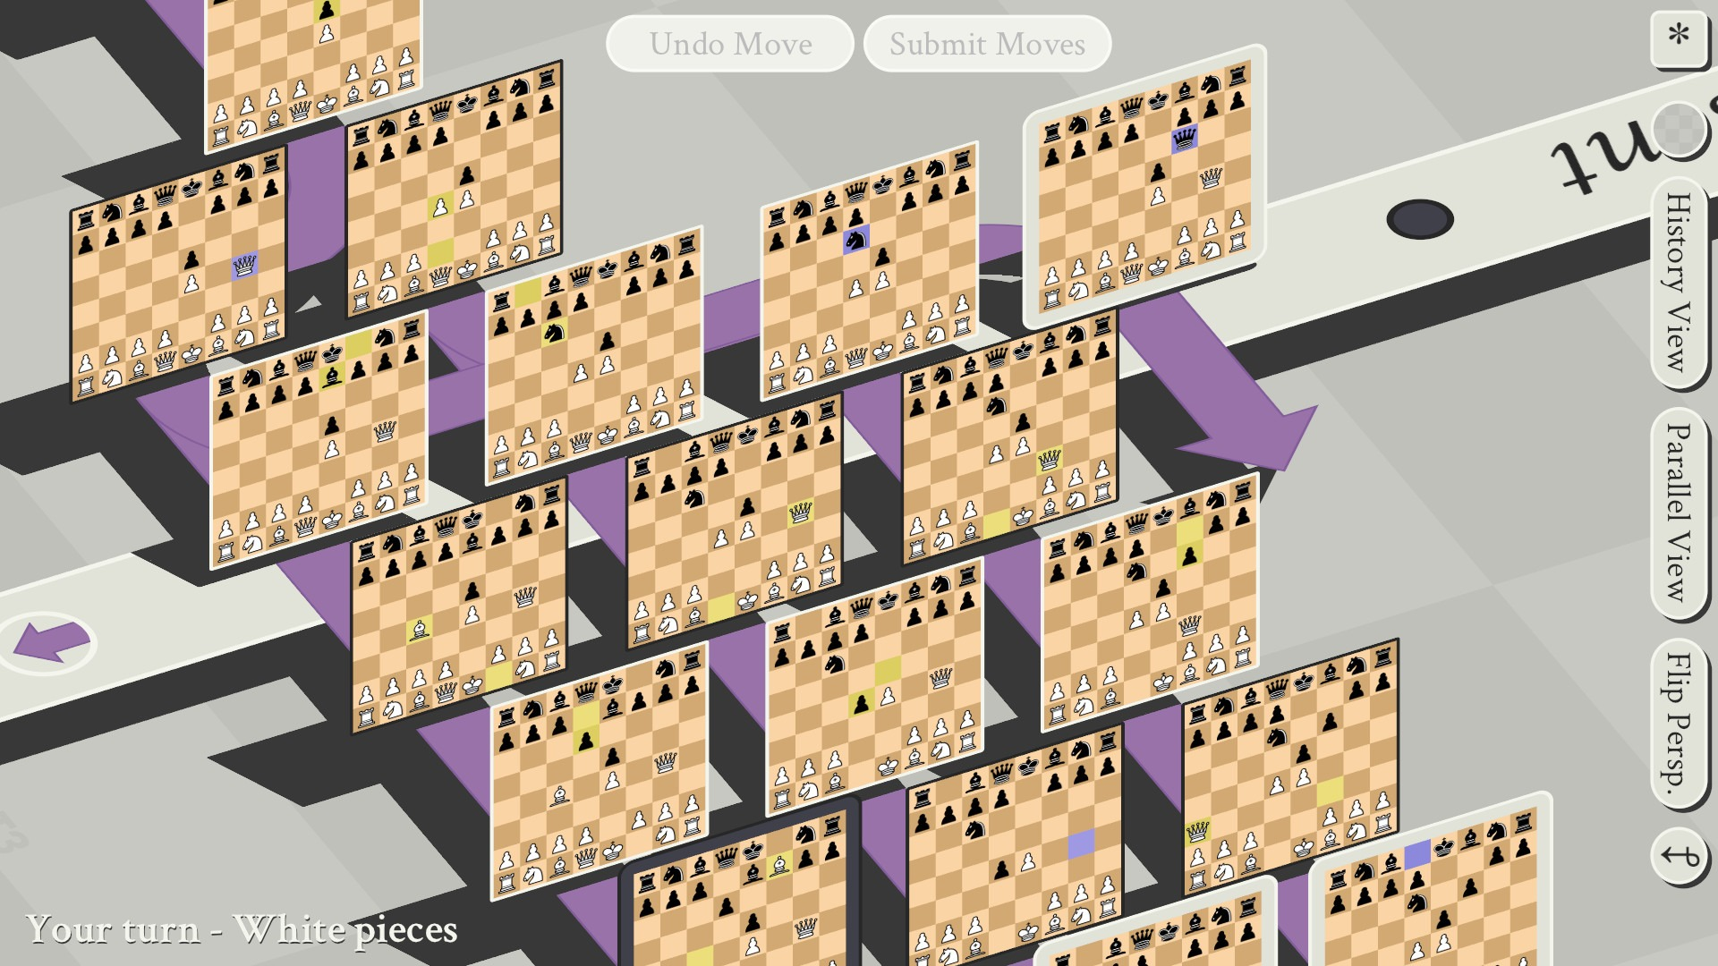

What We’ll Talk About Today
Arrays
Loops
Command-Line
Command-Line Args
Chess Example

Slide 3
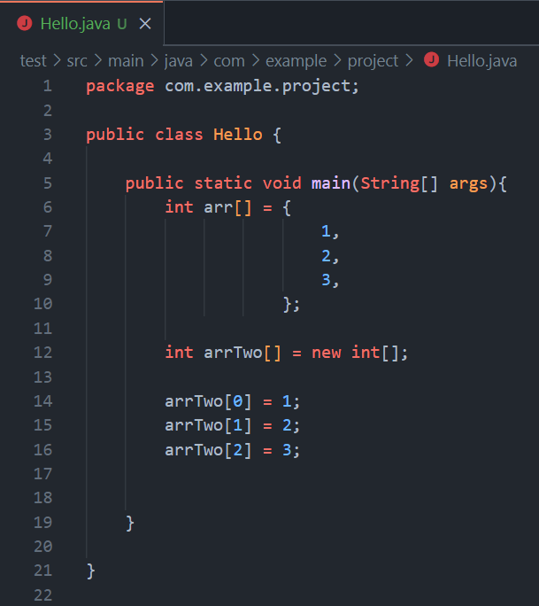
Arrays
Can be made in two ways.

Slide 4
Arrays
Can be made in two ways.
Can hold any primitive data type and in many cases non-primitive data types.

Slide 5
Arrays
Can be made in two ways.
Can hold any primitive data type and in many cases non-primitive data types.
Uses zero-indexing.

Slide 6
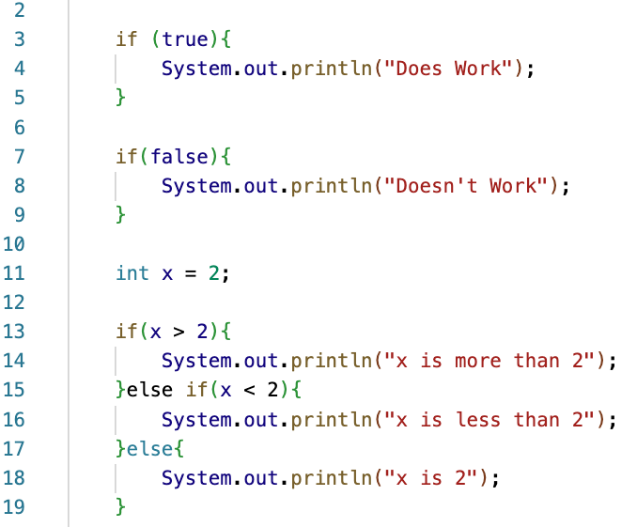
Most Basic Conditional
The most basic conditionals in Java are the “if”, “else”, and “else if” statements.
Each of them act on some expression surrounded by parentheses which resolves to some Boolean value.

Slide 7
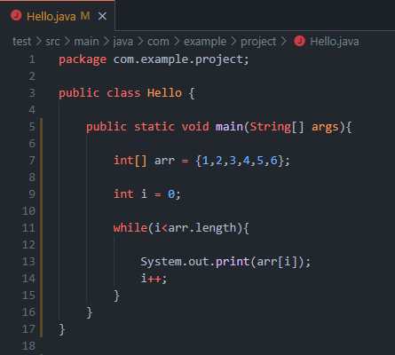
While Loops
Simplest Form of Loop.

Slide 8
While Loops
Simplest Form of Loop.
Primarily useful when looping on a trigger instead of a count.

Slide 9
While Loops
Simplest Form of Loop.
Primarily useful when looping on a trigger instead of a count.
Should be controlled but will not throw an error when it goes infinite.

Slide 10
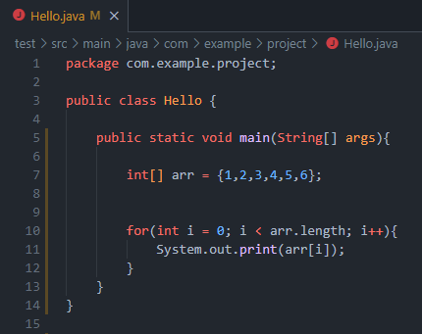
For Loops
A more refined, count based Loop.

Slide 11
For Loops
A more refined, count based Loop.
Good for keeping track of loop iteration while running.

Slide 12
For Loops
A more refined, count based Loop.
Good for keeping track of loop iteration while running.
Is just a combination of the same fundamental parts we used in the While Loop example.

Slide 13
For Loops

Slide 14
For Loops

Slide 15
For Loops

Slide 16
For Loops

Slide 17
For Loops

Slide 18
For Loops

Slide 19
For Loops

Slide 20
For Loops

Slide 21
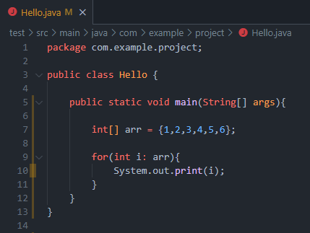
For Each Loops
A more refined, modern, and simple loop.

Slide 22
For Each Loops
A more refined, modern, and simple loop.
Good for a more simple coverage loop.

Slide 23
For Each Loops
A more refined, modern, and simple loop.
Good for a more simple coverage loop.
Can handle scaling well and can be easily made generic in order to handle all sorts of types.

Slide 24
For Each Loops
Can be read “for each { int i } in { arr }”.

Slide 25
Command-Line
For development the command line is essential.
There are often GUI workarounds for any given tool, but by consistently opting for these workarounds you expose yourself to a number of risks.
You may never commit yourself to learning the Command-Line and may miss out on cutting edge tools right after their conception.
You sacrifice speed and efficiency in a field where that is highly valued.
You may miss project structure faux-pas that would be obvious to a command line user.
Your coworkers may make fun of you.

Slide 26
Command-Line
So, as a result in this class you will be expected to learn and use some very basic command-line tools.
Not enough command-line tools, but some.

Slide 27
Command-Line
Starting with navigation:
In most Operating Systems and most terminals, you navigate using the command:
$ cd <some directory>
The directory name can be a simple file name or potentially a path across your hard-drive.
$ cd Luther
$ cd /Users/sam.luther/Code/322/public/Luther
$ cd ../Luther
$ cd ./Luther

Slide 28
Command-Line
As with real life you necessarily must know your location in order to prescribe a route.
Next, we have the commands needed to find yourself:
$ pwd
This command will simply print out your current location within you file sytem.
“pwd” stands for print working directory
$ ls <some directory>
This command tells you what files and folders are present at that location.
Like opening a finder or file explorer window at that location.
When no directory is provided after the “ls” it will simply list files wherever you are.

Slide 29
Command-Line
Different commands can also have flags.
For example, if you add the “–a” flag to a “ls” command it will list all files AND all hidden files at that location.
And in some projects being able to see hidden files is quite often essential.
Hidden files/folders in your system will most often have a leading dot “.” on their name, for example:
.git
.firebase
.gitignore

Slide 30
Command-Line
The final thing we’ll cover today is a basic way of interacting with files.
More specifically how to delete them over the command line:
$ rm <some file>
$ rm –rf <some directory>

Slide 31

Do not under any circumstances type “rm –rf” from a high location or using the “/” argument.
$ rm –rf /* would delete everything!!!

Slide 32
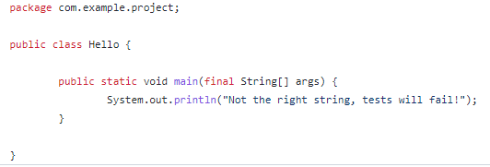
Command Line Args
Part of the boilerplate you’ve always had

Slide 33
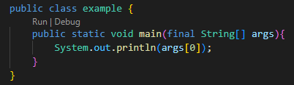

Command Line Args
Can be used on the command line with the Java command like so:

Slide 34
Command Line Args
Can be called in code just as args[some index] or iterated over in some sort of loop.

Slide 35
Command Line Args
Can be called in code just as args[some index] or iterated over in some sort of loop.
If empty and called will throw a runtime exception.

Slide 36
Command Line Args
Can be called in code just as args[some index] or iterated over in some sort of loop.
If empty and called will throw a runtime exception.
Uses spaces to separate and can be chunked with quotes.

Slide 37
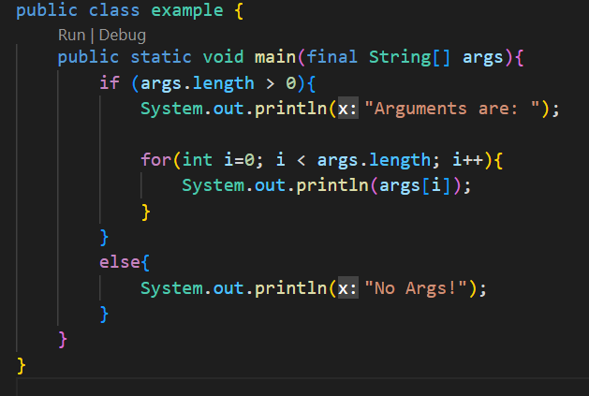
Command Line Args
So a program with multiple command line arguments may look like this:

Slide 38
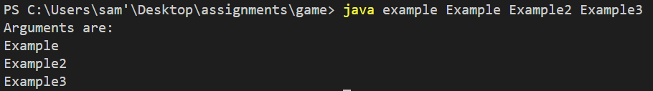

Slide 39
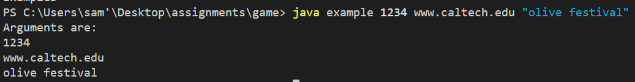

Slide 40
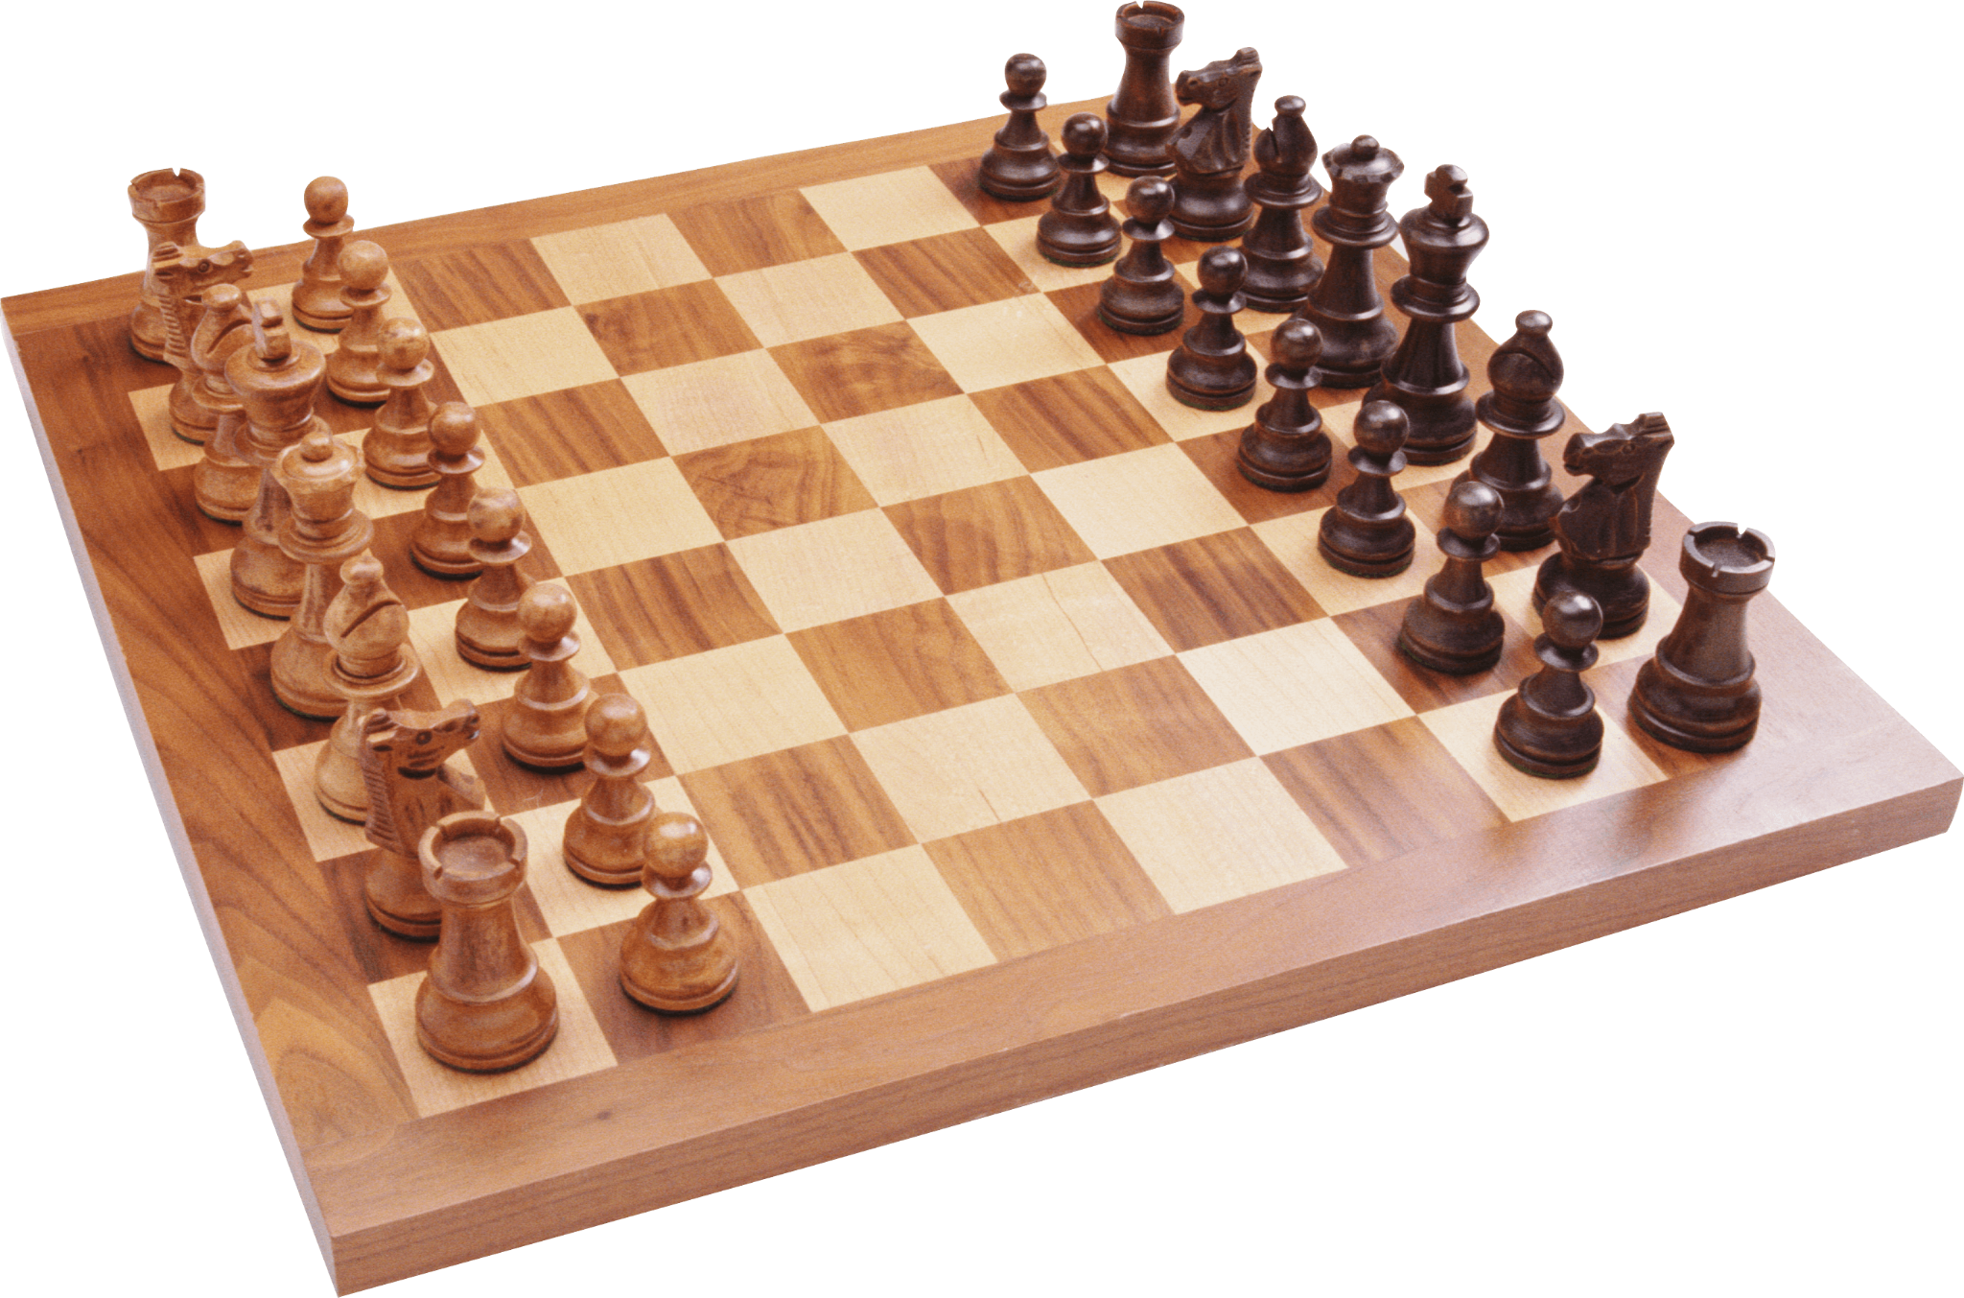
Chess Example
x-axis
y-axis
Unicode Pieces: ♖♘♗♔♕♗♘♖
♙♙♙♙♙♙♙♙
♟︎♟︎♟︎♟︎♟♟︎♟︎♟︎
♜♞♝♛♚♝♞♜
You may need to run:
chcp 65001
In your terminal if these characters don’t show up.
T
I
M
E

Slide 41
Closing
Please Read: 1.2 and 1.3 Built-in Types of Data and Conditionals and Loops
Office Hours In SS-409:
Tu & Th 4:20pm – 5pm
Mon & Wed 1pm–4pm
TA Office Hours in the Fishbowl:
Mon & Wed 2pm–3pm
Have a great first week and I’ll see you on Friday!

